Slide 1
Project 3 Presentation
By: Devin Hopkins

Slide 2
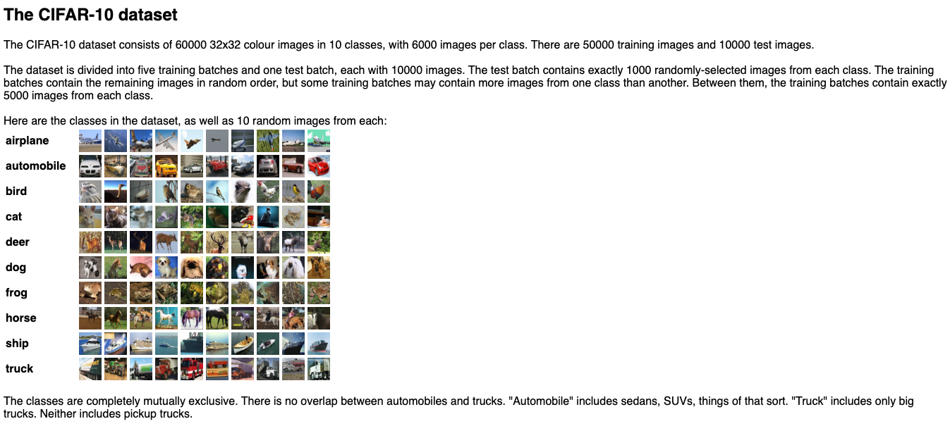
Research
Started by researching the CIFAR-10 dataset
Consists of 60,000 images (50,000 training and 10,000 test images)
10 classes
Random order
Tons of variety

Slide 3
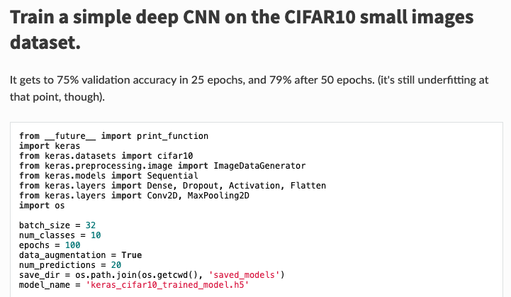
Research
Started researching the model used from the Keras website
Found here: ﻿https://keras.io/examples/cifar10_cnn/
Went through the layers and what each layer did

Slide 4
Terms Learned
Before diving into the layers, wanted to define some terms I came across
Note: Not every term used in the layer is described here, just the more important terms
Padding
Padding keeps the output the same shape as the input
Kernel Size
The number of pixels a layer looks at while focusing on one pixel
Activation
How the layer decides what to output given the input

Slide 5
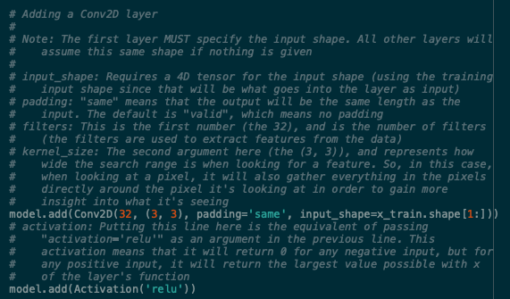
1st Layer
Conv2D Layer

Slide 6

2nd Layer
Conv2D Layer

Slide 7
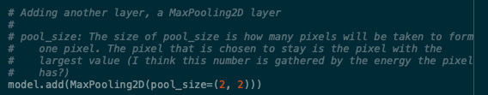
3rd Layer
MaxPooling2D Layer

Slide 8
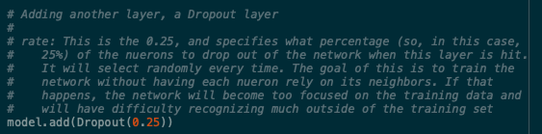
4th Layer
Dropout Layer
Note: There is an error with the comment above. When a neuron hits this layer, it has a 25% chance to dropout. This layer does not mean that exactly 25% of the neurons drop out.

Slide 9
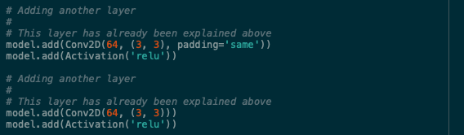
5th and 6th Layer
Both Conv2D layers
The 5th and 6th layers are the same as the 1st and 2nd layer, respectively

Slide 10
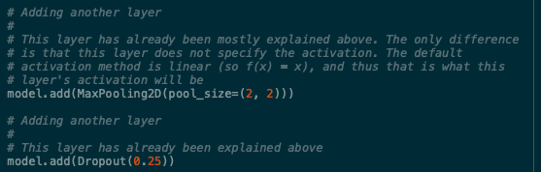
7th and 8th Layers
7th layer is a MaxPooling2D layer, the same as the 3rd layer
8th layer is a Dropout layer, the same as the 4th layer

Slide 11

9th Layer
Flatten Layer

Slide 12
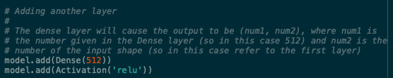
10th Layer
Dense Layer

Slide 13

11th Layer
Dropout Layer
Same as layers 4 and 8

Slide 14
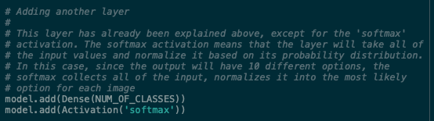
12th Layer
Dense Layer
Final layer

Slide 15
Test Cases
Ran test cases to test three variables
Variables tested:
Data Augmentation
Batch Size
Epochs

Slide 16
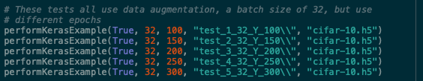
Epoch Testing
Ran five tests, each with different epochs

Slide 17
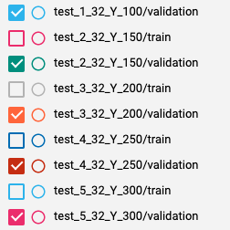
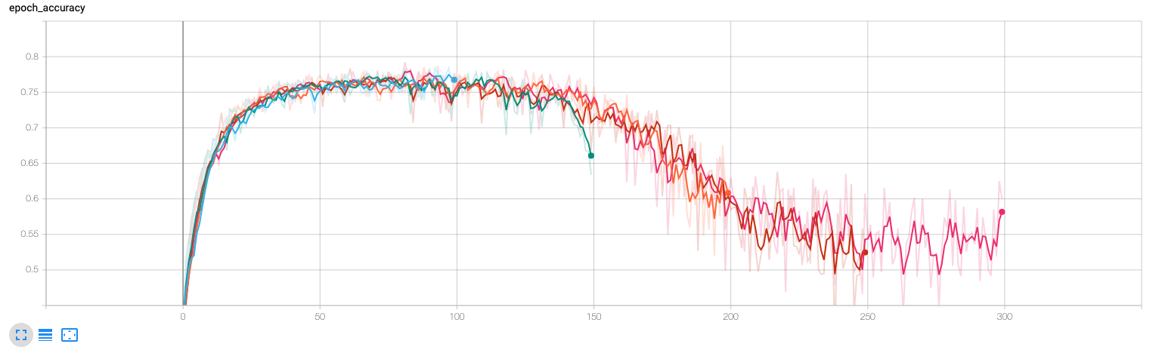
Results
The best epoch number seemed to be around 110 to 120

Slide 18
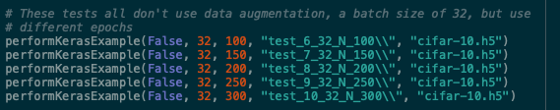
Data Augmentation Testing
Ran five tests, each matching a test from the epochs, but without using data augmentation

Slide 19
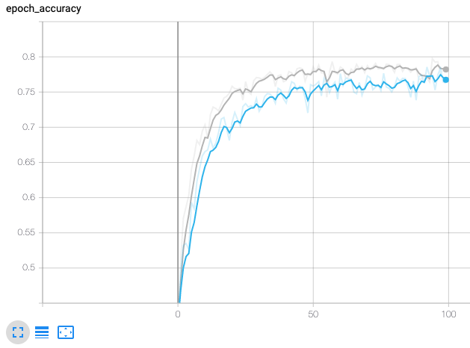
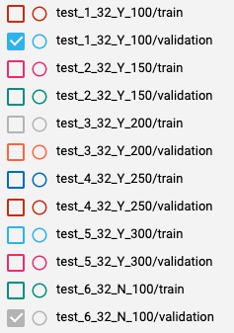
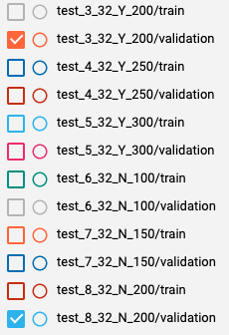
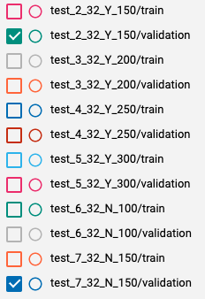
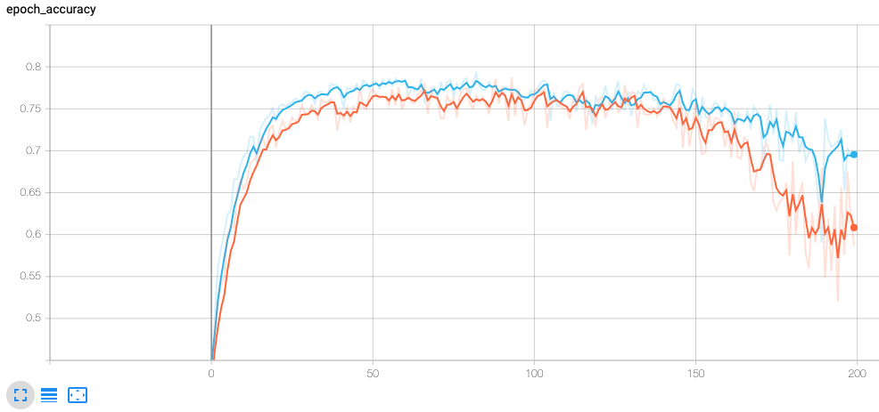
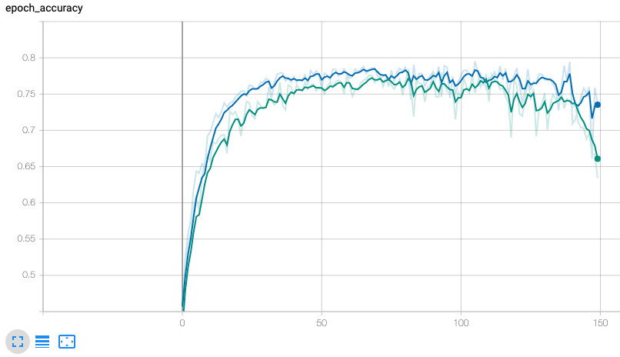
Results Part 1
Not using data augmentation seemed to do slightly better in all cases

Slide 20
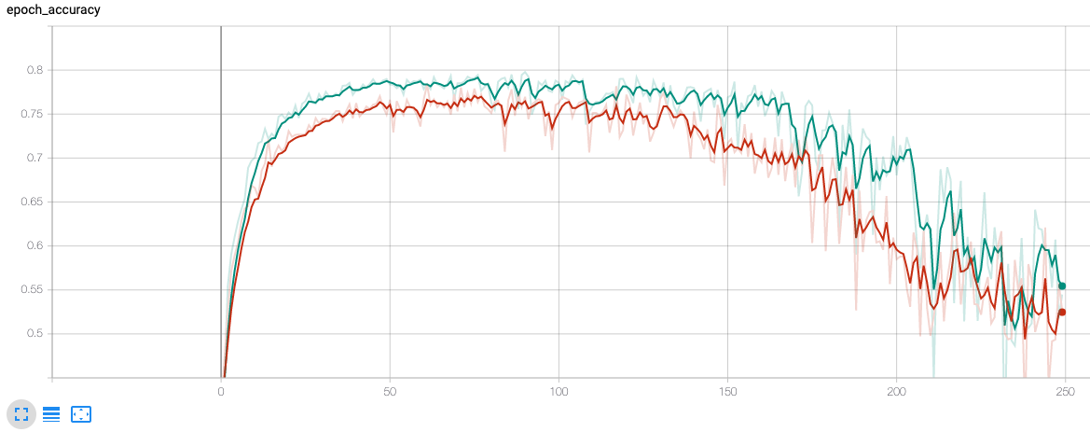
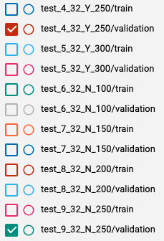
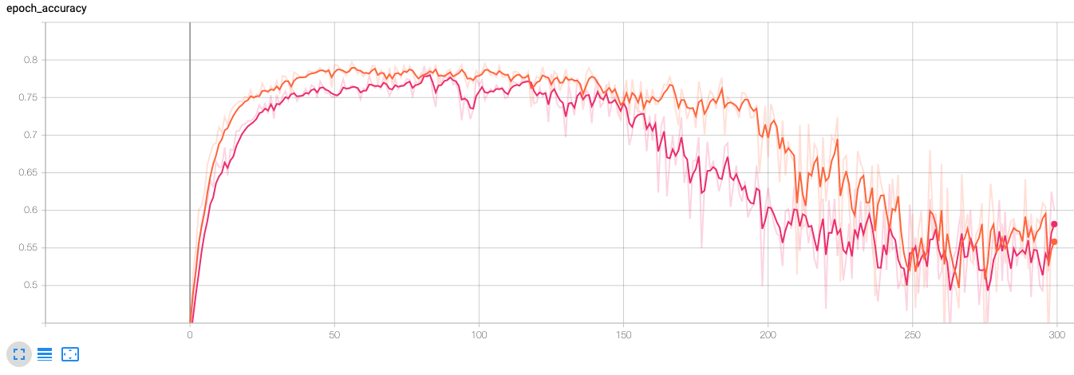
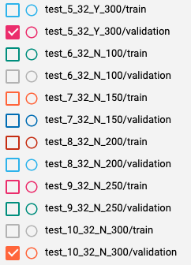
Results Part 2
Not using data augmentation seemed to do slightly better in all cases

Slide 21
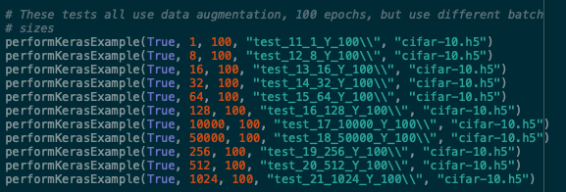
Batch Size Testing
Ran 11 tests, each with different batch sizes

Slide 22
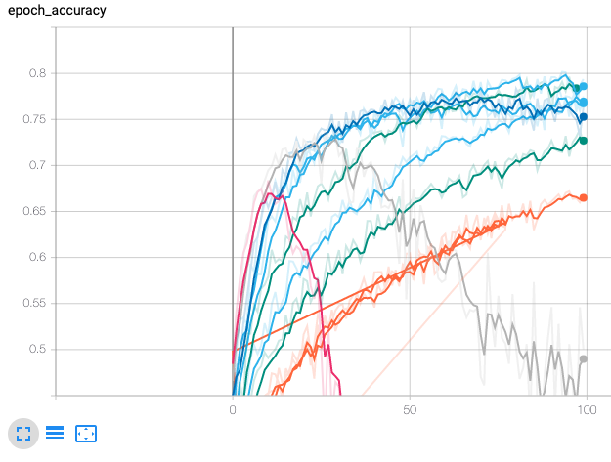

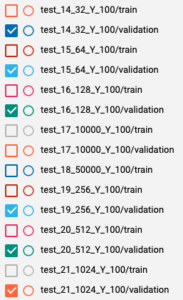
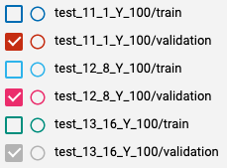
Results
Most tests performed worse when compared to test 1
However, tests 15 and 16 with batch sizes of 64 and 128, respectively, performed better
Test 16 performed better than test 15

Slide 23
Thoughts for the Future
Optimal test likely using:
No data augmentation
110 to 120 epochs
Batch size of around 128

Slide 24
Additional Changes Made
After displaying my network and findings to the class and watching other people’s presentations, I came to 2 conclusions:
I should make my own model
I should use the Adam optimizer

Slide 25

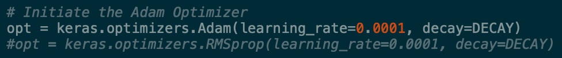
My Model
Very similar to the Keras example, but with 2 key differences:
After every layer, the batch is normalized
Rather than using the RMS prop optimizer, I used the Adam optimizer

Slide 26
Tests
I ran several more tests and tweaked my model accordingly
My best test was one with the following conditions:
150 Epochs
Using Data Augmentation
Batch Size of 128
I compared it with the same variables on the Keras example

Slide 27
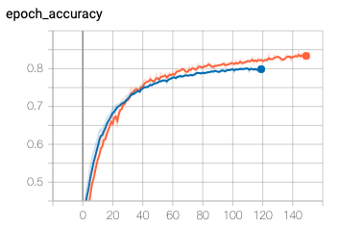
Result
Here, the orange is the optimal model and the blue is the normal Keras example
My model ended with about 84% accuracy, whereas the Keras example got to about 79.5%

